Slide 1
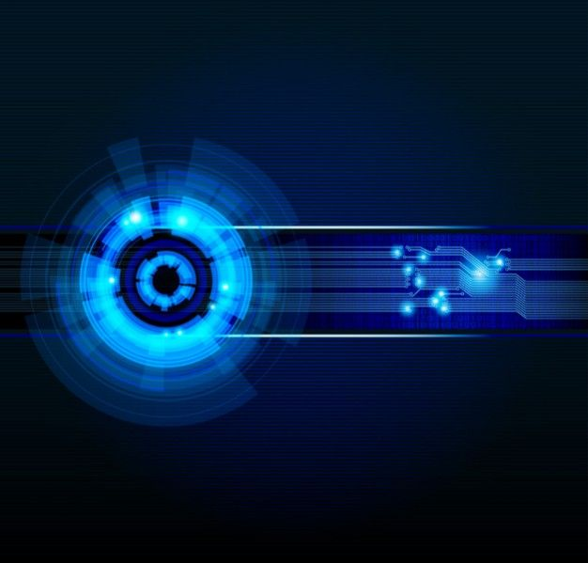
PRESENTATION ON SMART DEVICES
SUBMITTED TO :- SUBMITTED BY :-
MISS RICHA MA’AM LALIT CHOUHAN(0801CS141042)

Slide 2
WHAT IS SMART DEVICE?

Slide 3
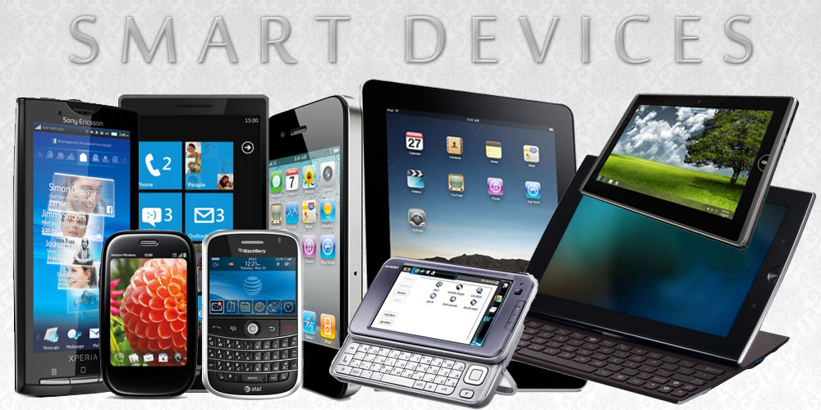
A smart device is an electronic device, generally connected to other devices or networks via different protocols such as Bluetooth, NFC,Wi-Fi, Internet, etc., that can operate to some extent interactively and autonomously

Slide 4
What smart devices Possess/Characteristics
Set of system hardware and software.
Remote external service access and execution.
Access to external environment.
Ubiquitous computing properties.

Slide 5
Ubiquitous computing properties
Device Need to be Networked, distributed and transparently accessible.
Devices should operate to some extent autonomously.
Context awareness of an environment in order to optimize their operation in that environment.

Slide 6
Form factors
In 1991 Mark Weiser proposed three basic forms for ubiquitous system devices: tabs, pads and boards.
Tabs : accompanied or wearable centimetre sized devices, e.g. smart phones, smart cards etc.,
Pads : hand-held decimetre-sized devices,
e.g., laptops.
Boards : meter sized interactive display devices, e.g., horizontal surface computers and vertical smart boards.

Slide 7
Smart Gadgets & Devices List
Everything is getting smarter around us. New range of smart devices are being released everyday.

Slide 8
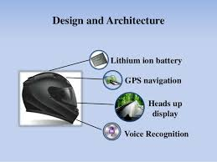
Smart helmet – You can see in 360 degree view with the smart helmet, so you can see even from back of your head through the camera which displays the information on the screen. It also has hands free calling, music playing and GPS

Slide 9
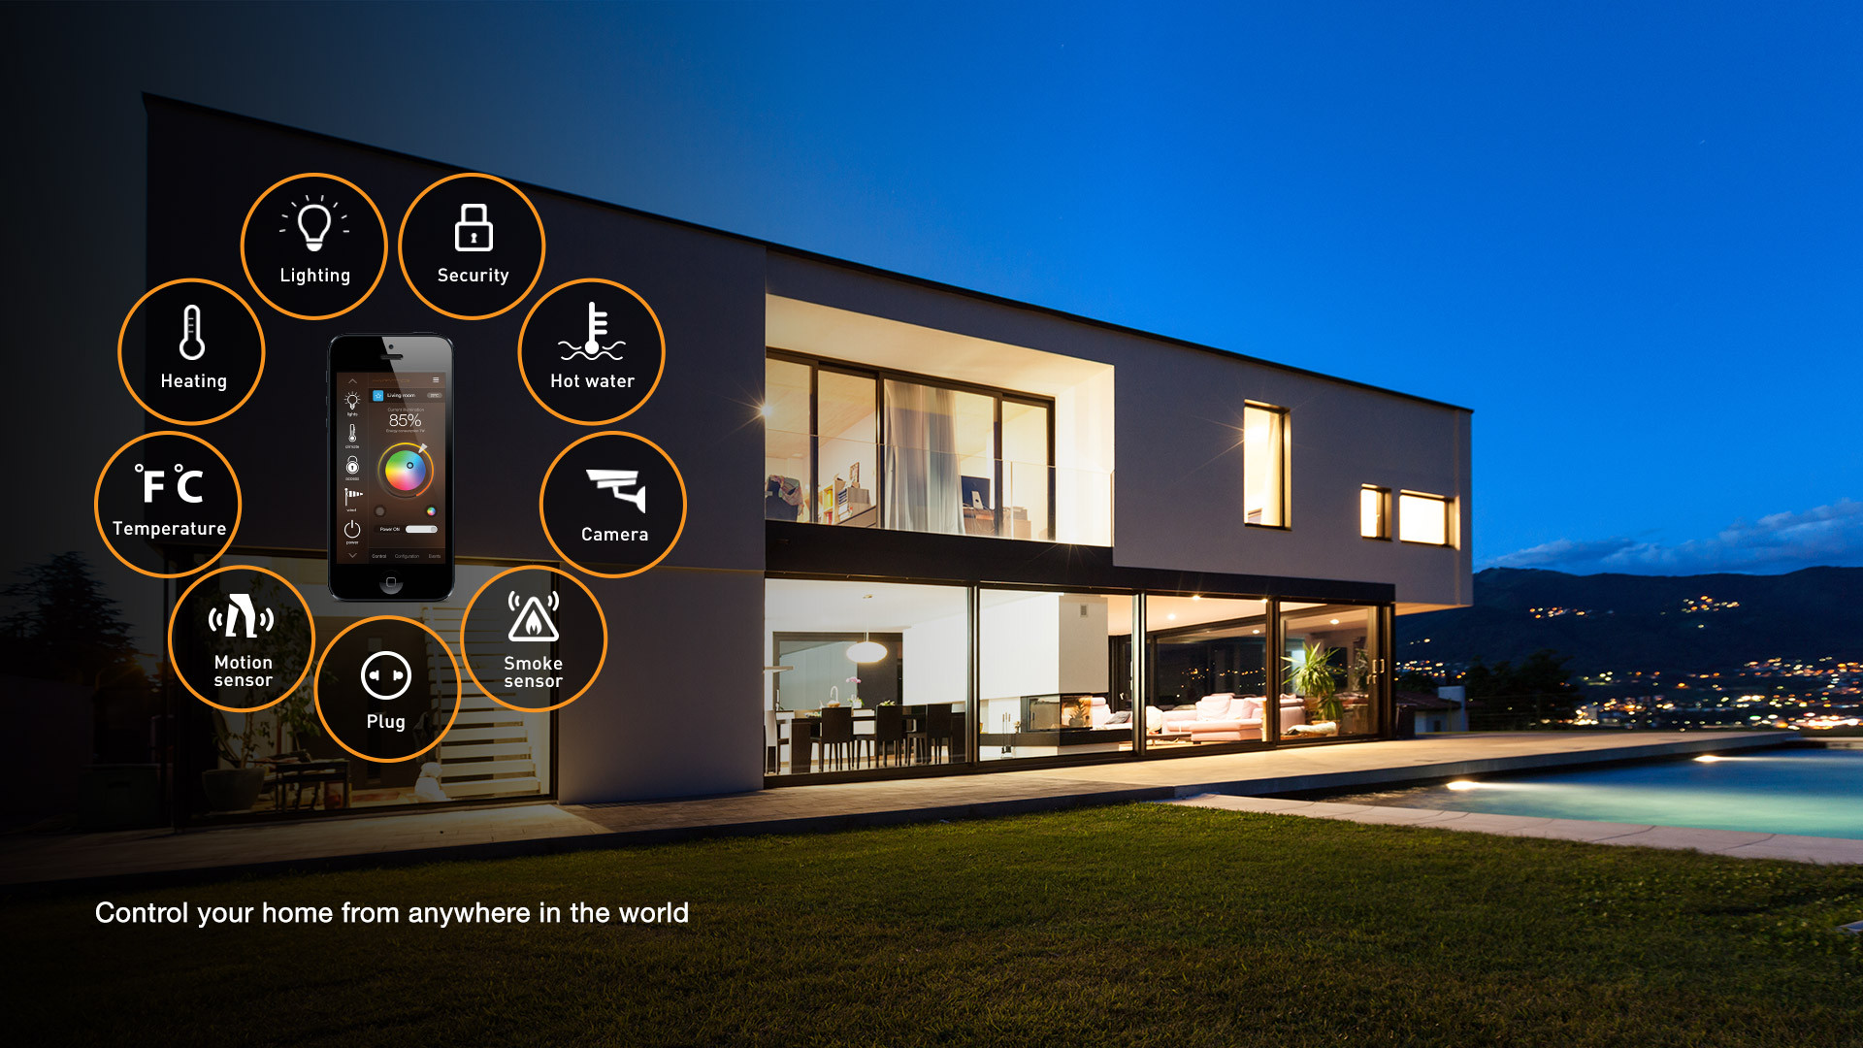
Smart home – Control all the home appliances with voice commands, fan with motion detection technology, wireless charging of gadgets and a lot more.

Slide 10
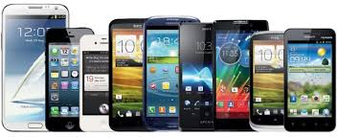
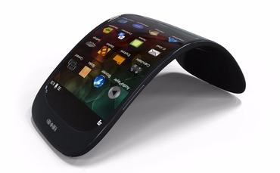
Smartphones – A smartphone is like a mini-computer which can multitask and can be used to call and messaging.

Slide 11
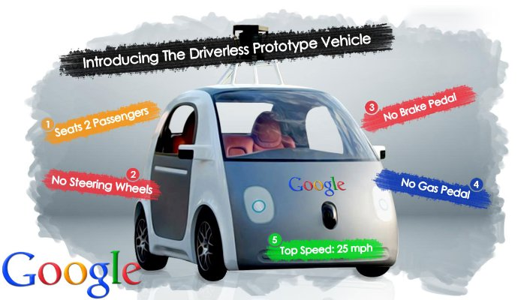
Smart Car

Slide 12
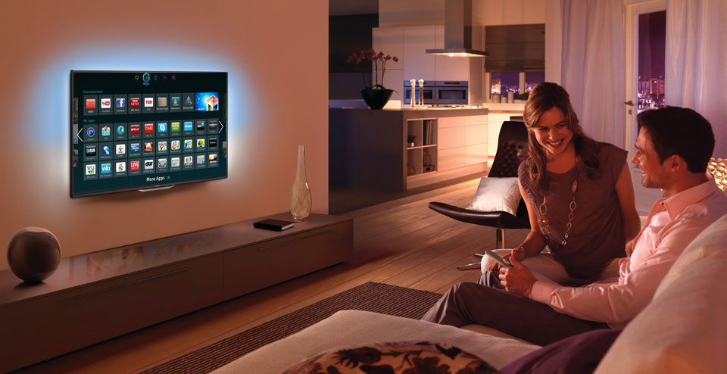
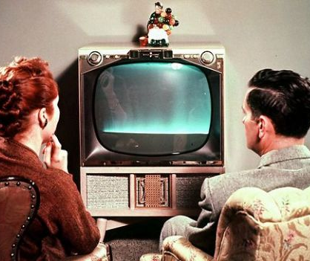
Smart TV
A television set or set-top box with integrated Internet and Web 2.0 features

Slide 13
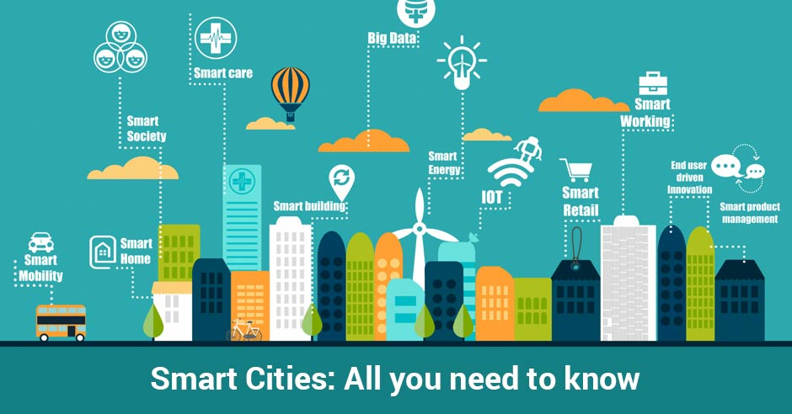
Smart city – A city with all resources for living, more alive, has advanced transport and living conditions.

Slide 14
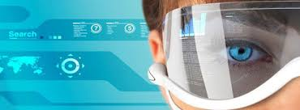
Smart glass
Sun glasses which displays information on the screen about speed, distance, height, name of places, information about the viewing objects, take photo by blinking twice, face recognition

Slide 15
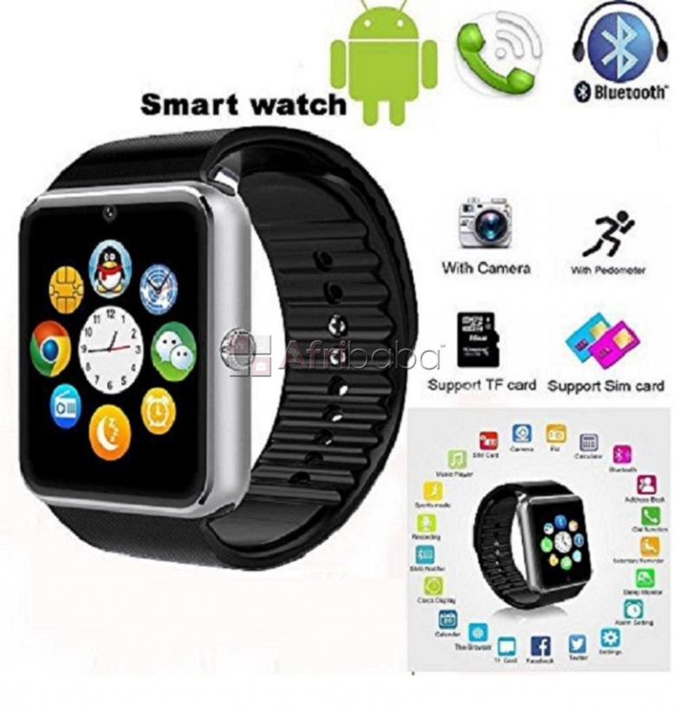
Smartwatch – It will show time, tracks your health, monitor your heart rate, shows distance you traveled, calories burned

Slide 16
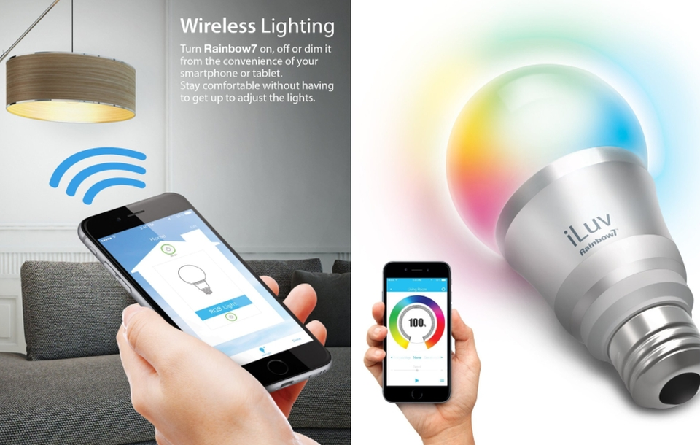
Smart LED Bulb

Slide 17
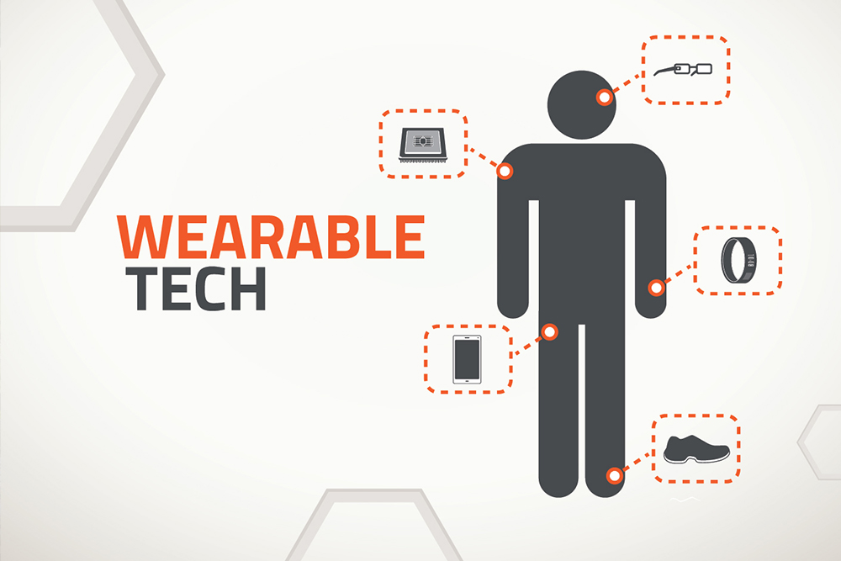
Wearables
Clothing and accessories incorporating computer and advanced electronic technologies

Slide 18
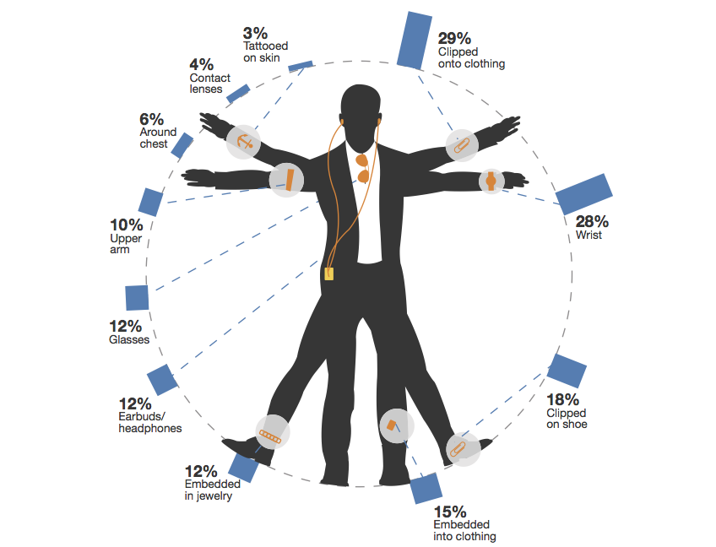
PEOPLE ARE INTERESTED

Slide 19
Components of SD
CPU (Central Processing Unit)
AMD
Intel
I/O (Input/Output)
Internet, Bluetooth
sensor, peripheral
OS (Operating System)
Mobile OS:
RTOS (Real-Time OS)

Slide 20

Some possible smart teach uses
Informal, self organised learning
Problem based learning
Group based activities
Distance learning

Slide 21
Some issues with Smart Devices
Security
Connectivity Problem
Reliability
Response Time / Latency
Fragmentation/Interoperability

Slide 22
Conclusion
Smart devices have good and bad sides.
According to the research smart devices only have the disadvantages of addiction and not using for the right purposes some times.
smart devices do have an effect on education in both good and bad ways. It makes study ,research easier but some students use them wrong manner.
In today’s world we really need smart devices because they are making us SMART.

Slide 23
References:
https://en.wikipedia.org/wiki/Smart_device
https://www.slideshare.net/bunnytiger007/smart-devices-41444355
http://iotlist.co/
mailto:adavy@tssg.org

Slide 24
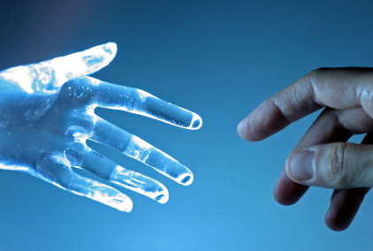
THANK YOU

